Slide 1
Dynamic Routing
1. RIP – ROUTING INFORMATION PROTOCOL
2. OSPF – OPEN SHORTEST PATH FIRST
3. EIGRP – ENHANCED INTERIOR GATEWAY PROTOCOL
4. BGP – BORDER GATEWAY PROTOCOL

Slide 2
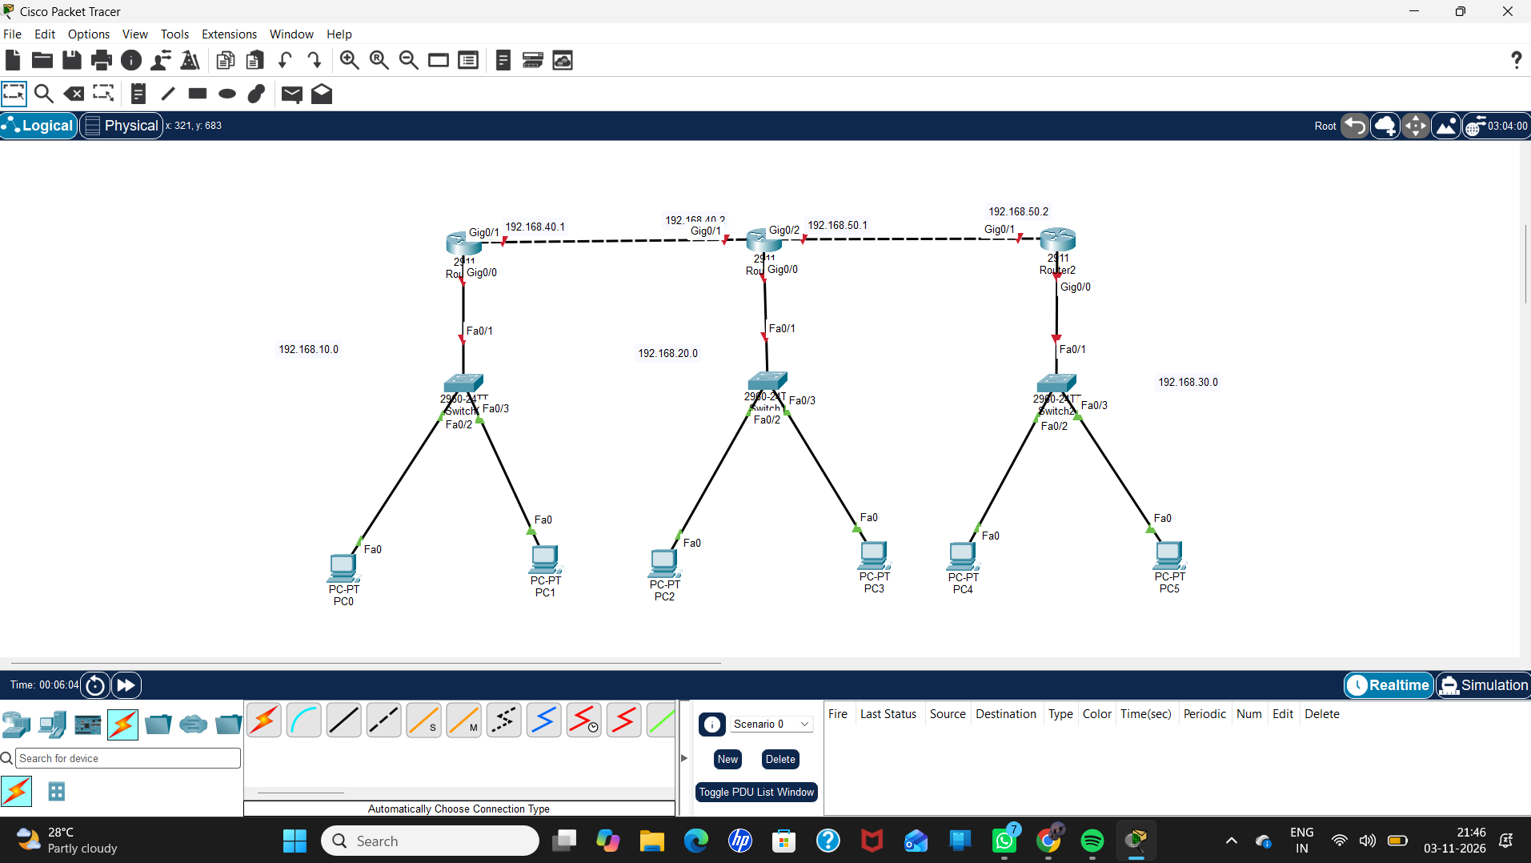
Devices:
3 ROUTER
3 SERVER
6 PC

Slide 3
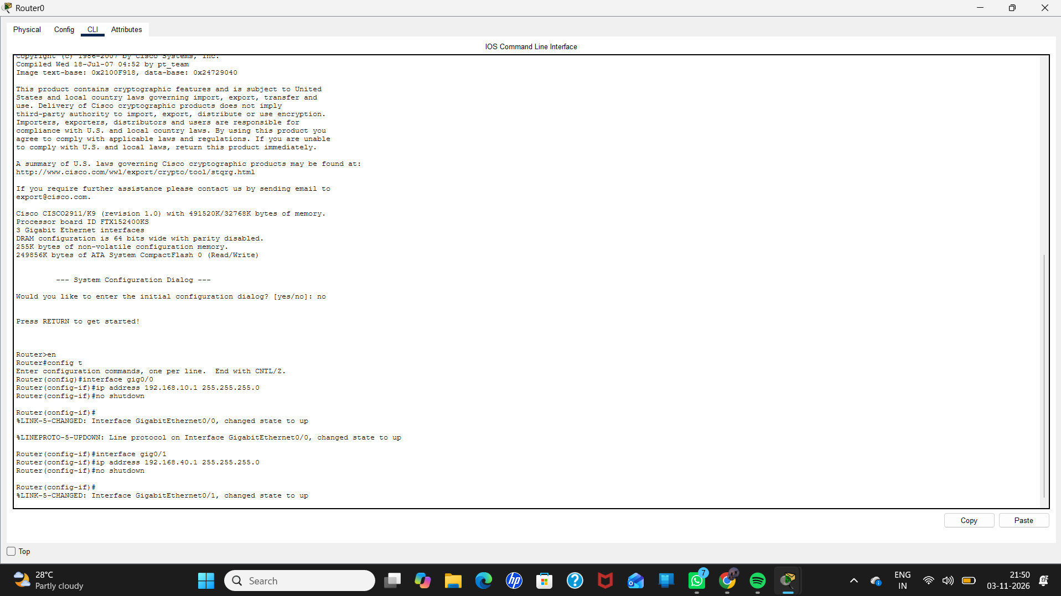
CONFIGURATION OF ROUTER 0

Slide 4
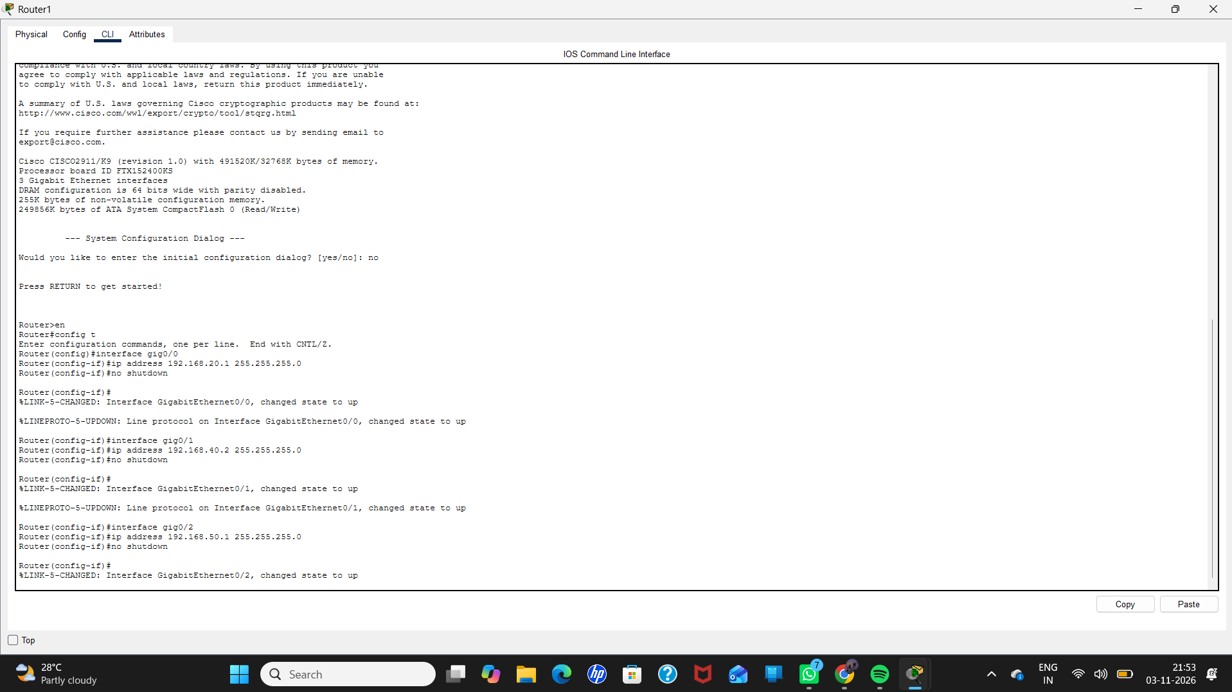
CONFIGURATION OF ROUTER 1

Slide 5
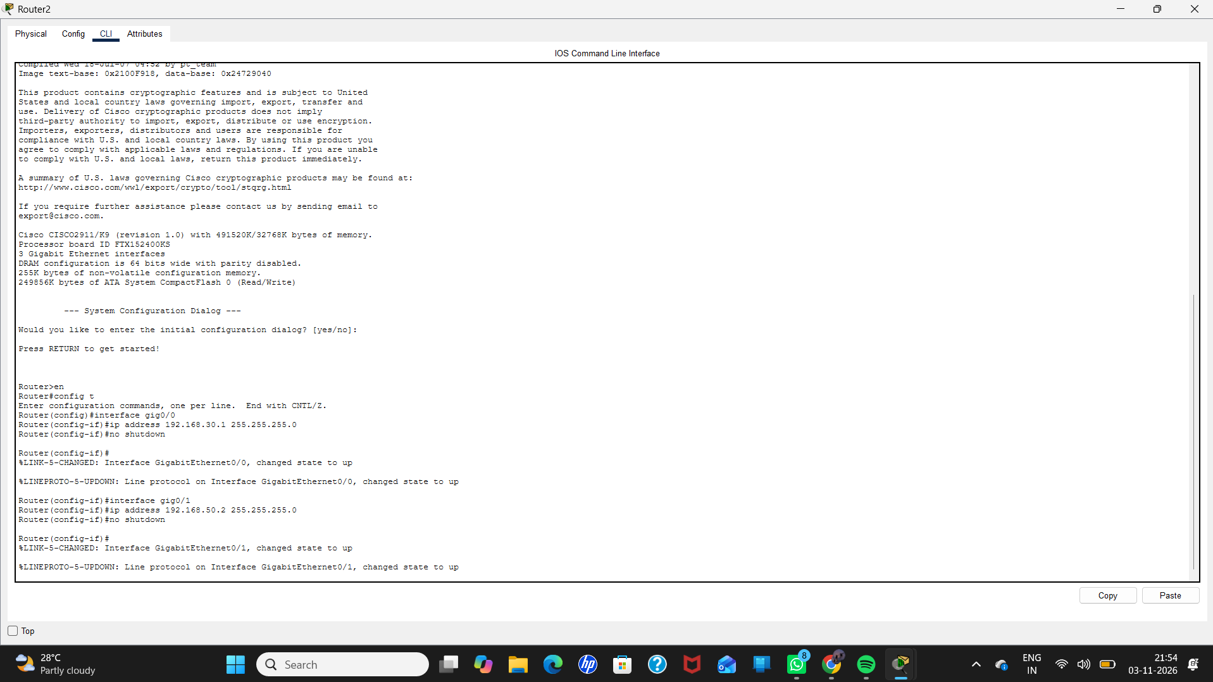
CONFIGURATION OF ROUTER 2

Slide 6
RIP – ROUTING INFORMATION PROTOCOL

Slide 7
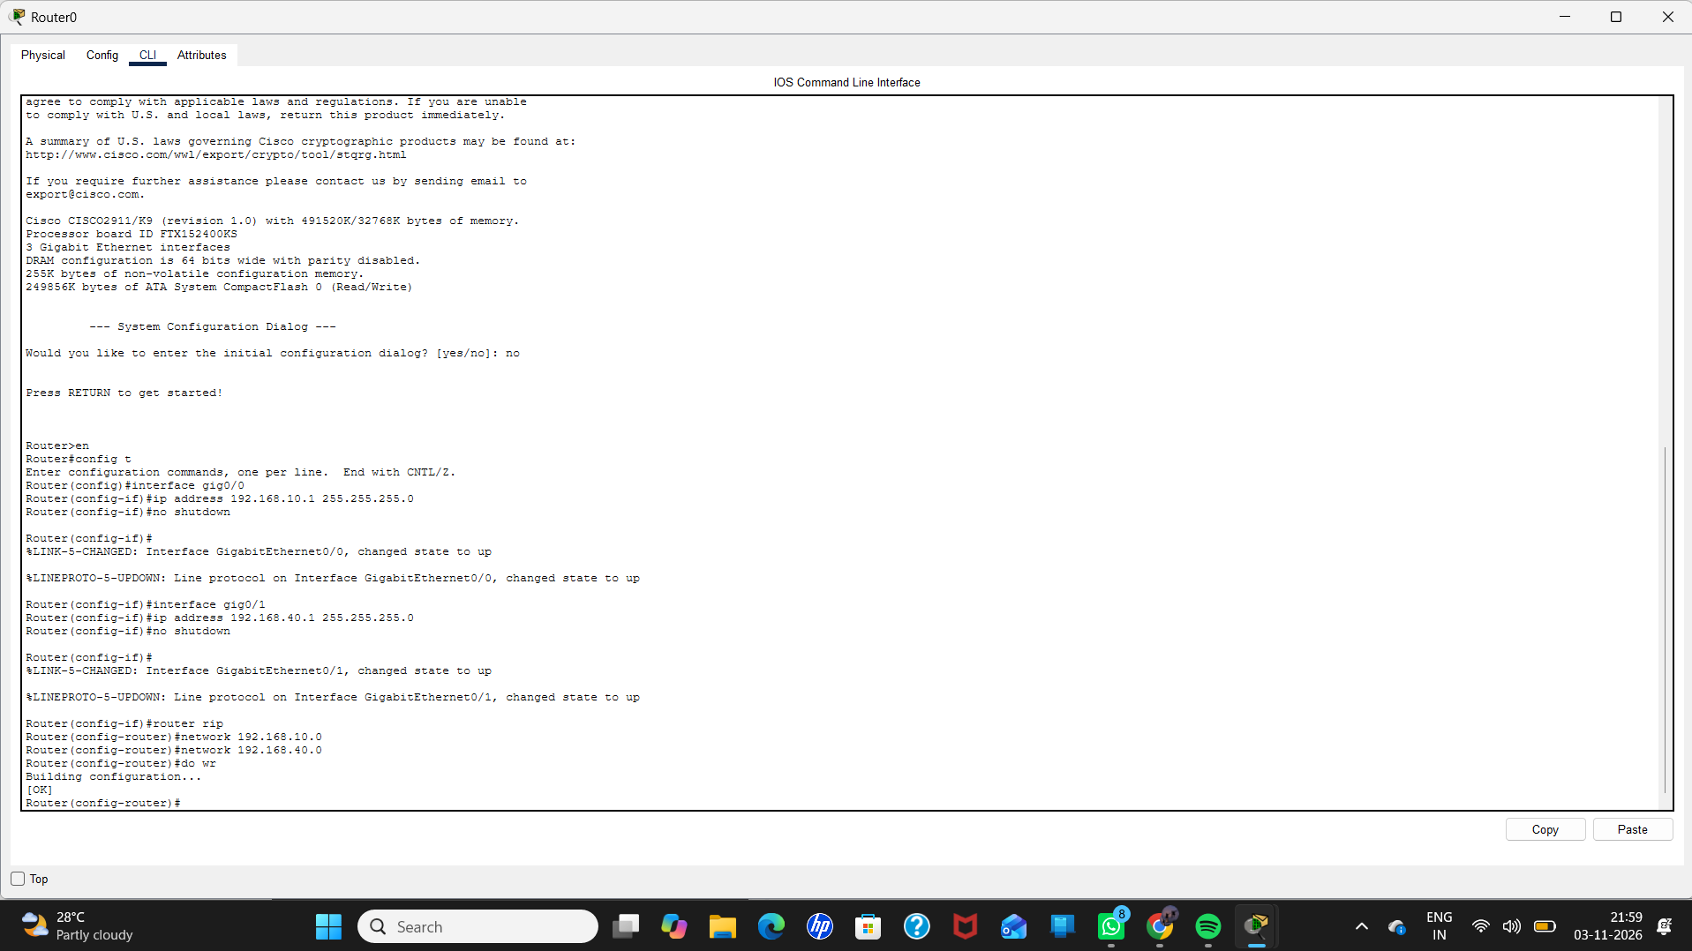

Slide 8
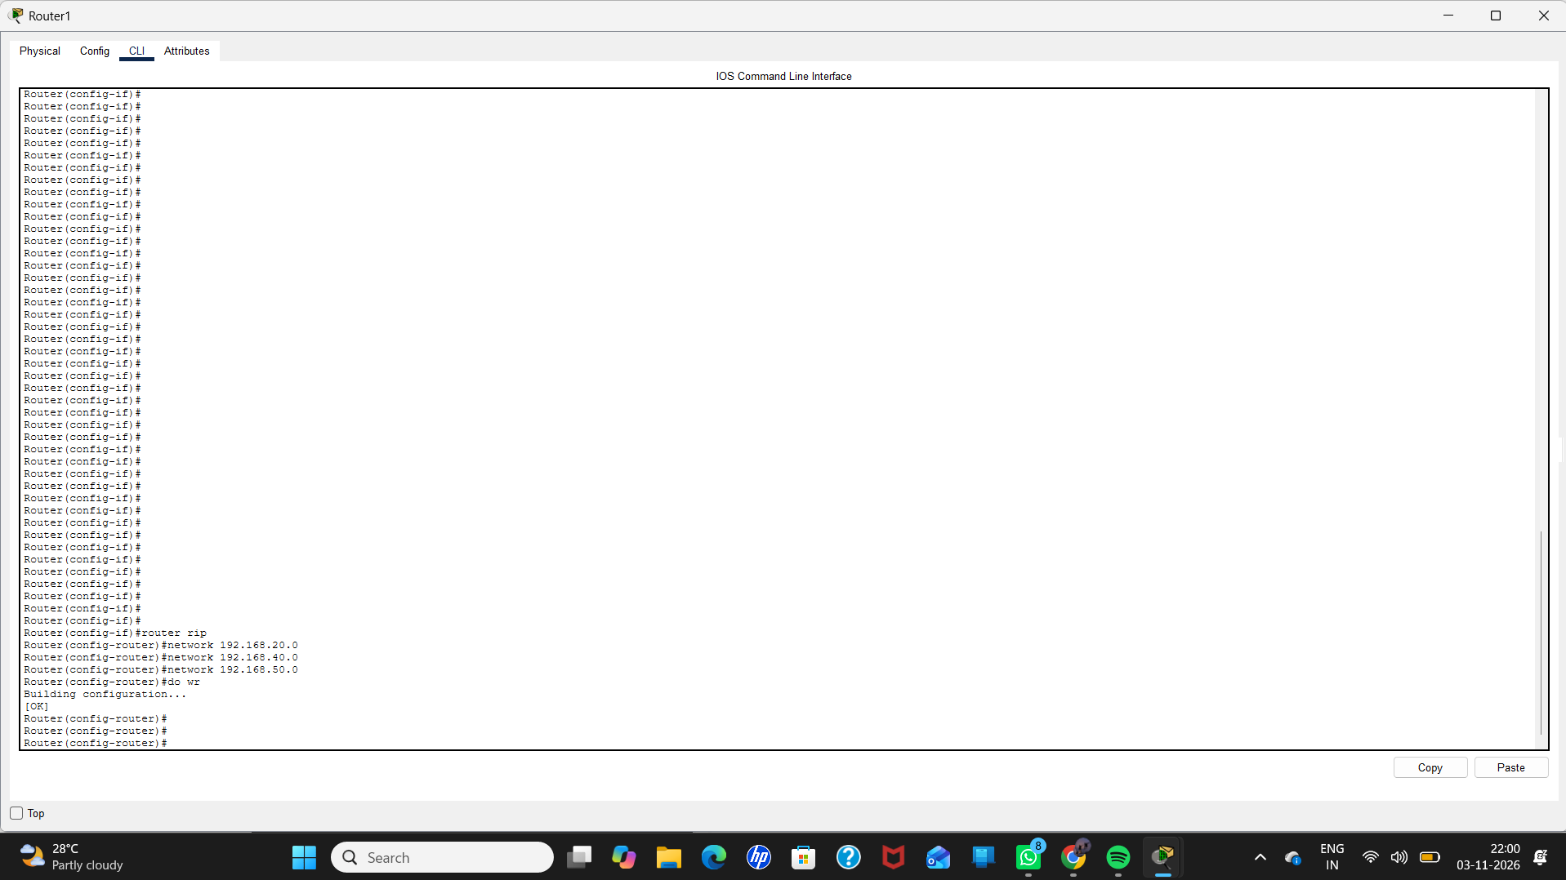

Slide 9
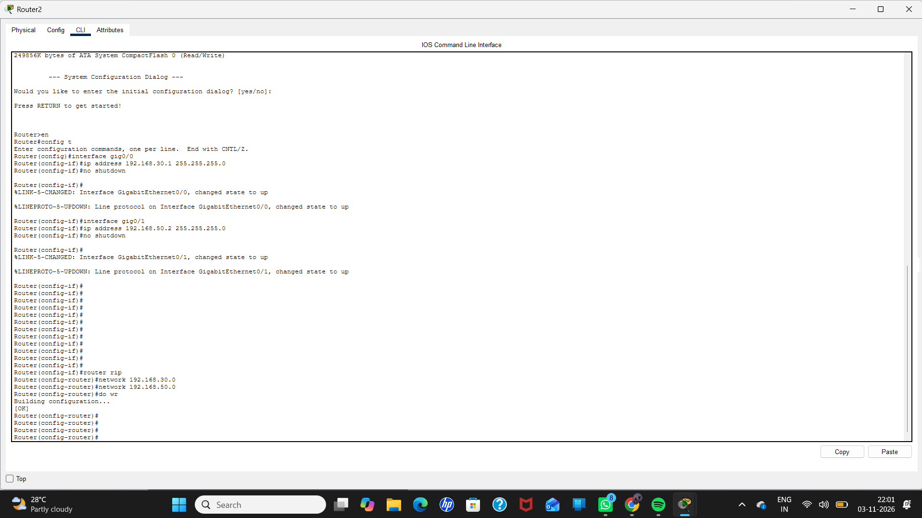

Slide 10
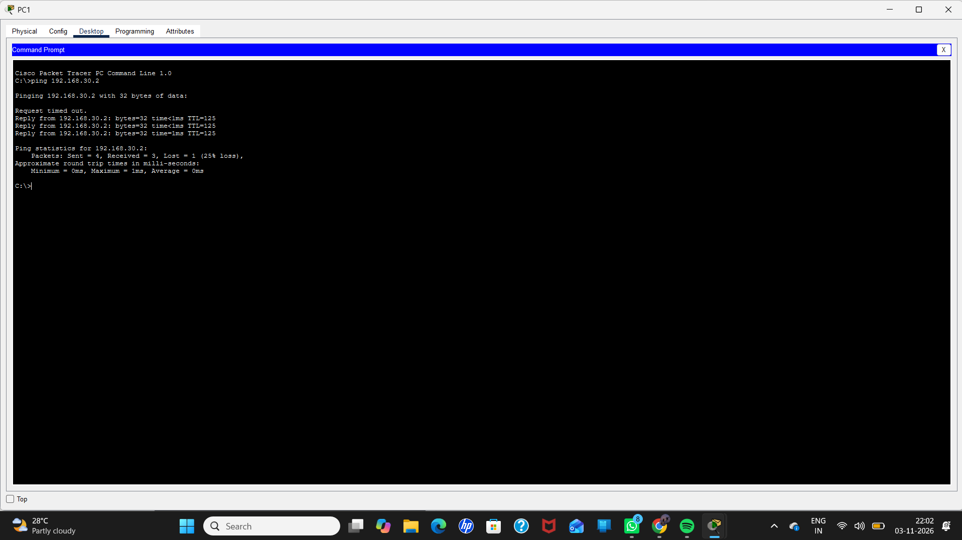

Slide 11
OSPF – OPEN SHORTEST PATH FIRST

Slide 12
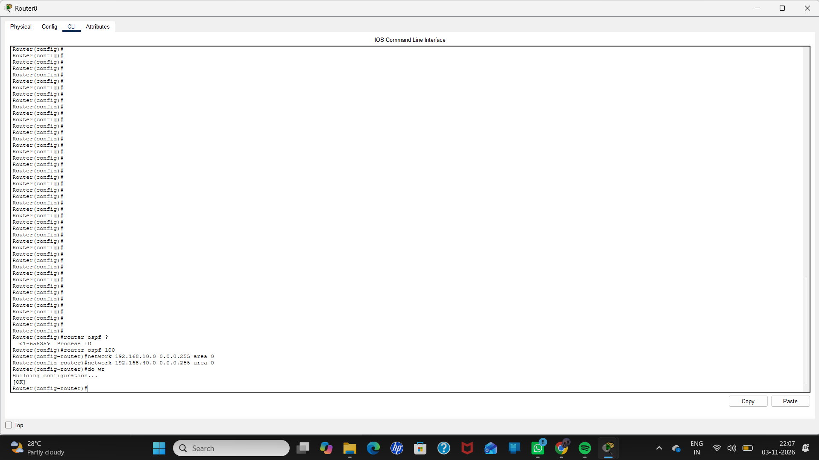

Slide 13
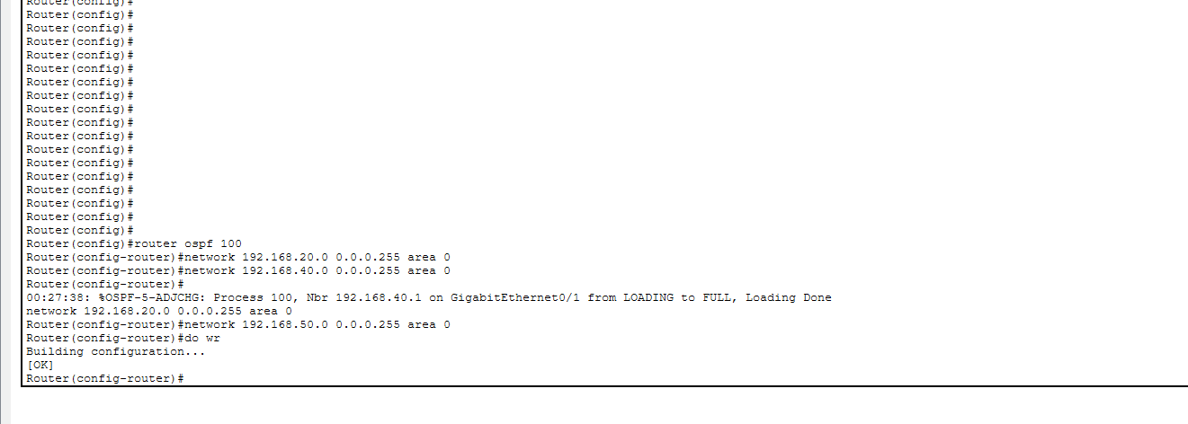

Slide 14
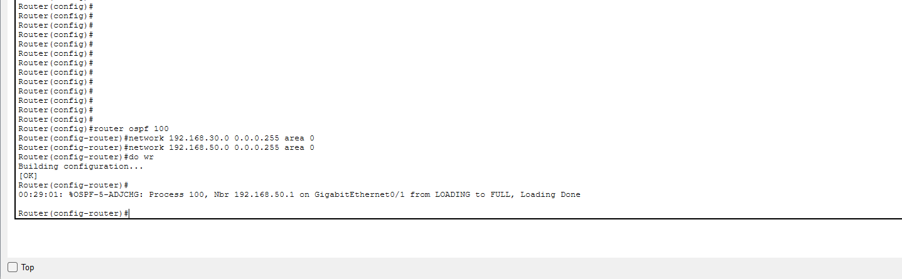

Slide 15


Slide 16
BGP – BORDER GATEWAY PROTOCOL

Slide 17
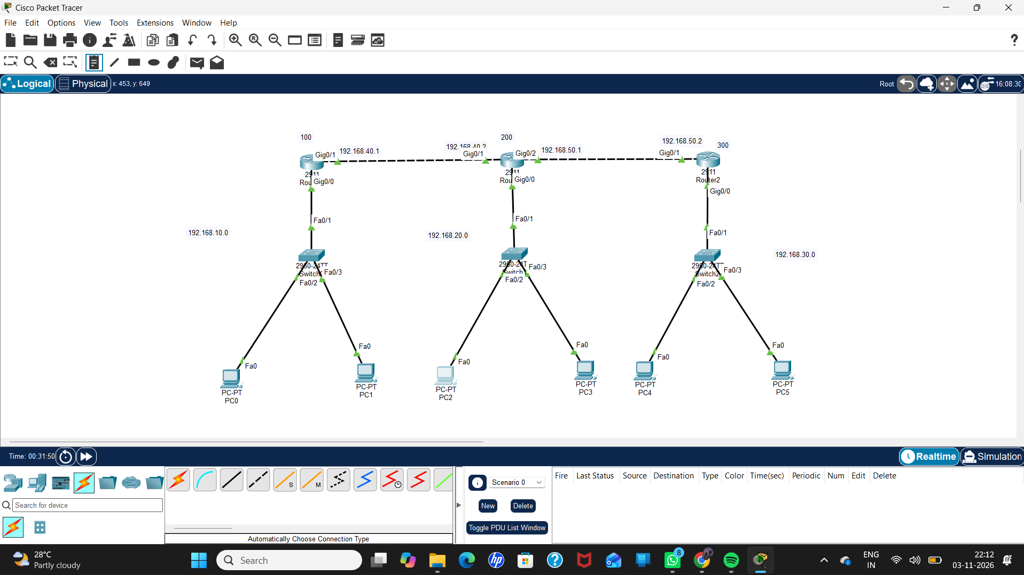

Slide 18


Slide 19
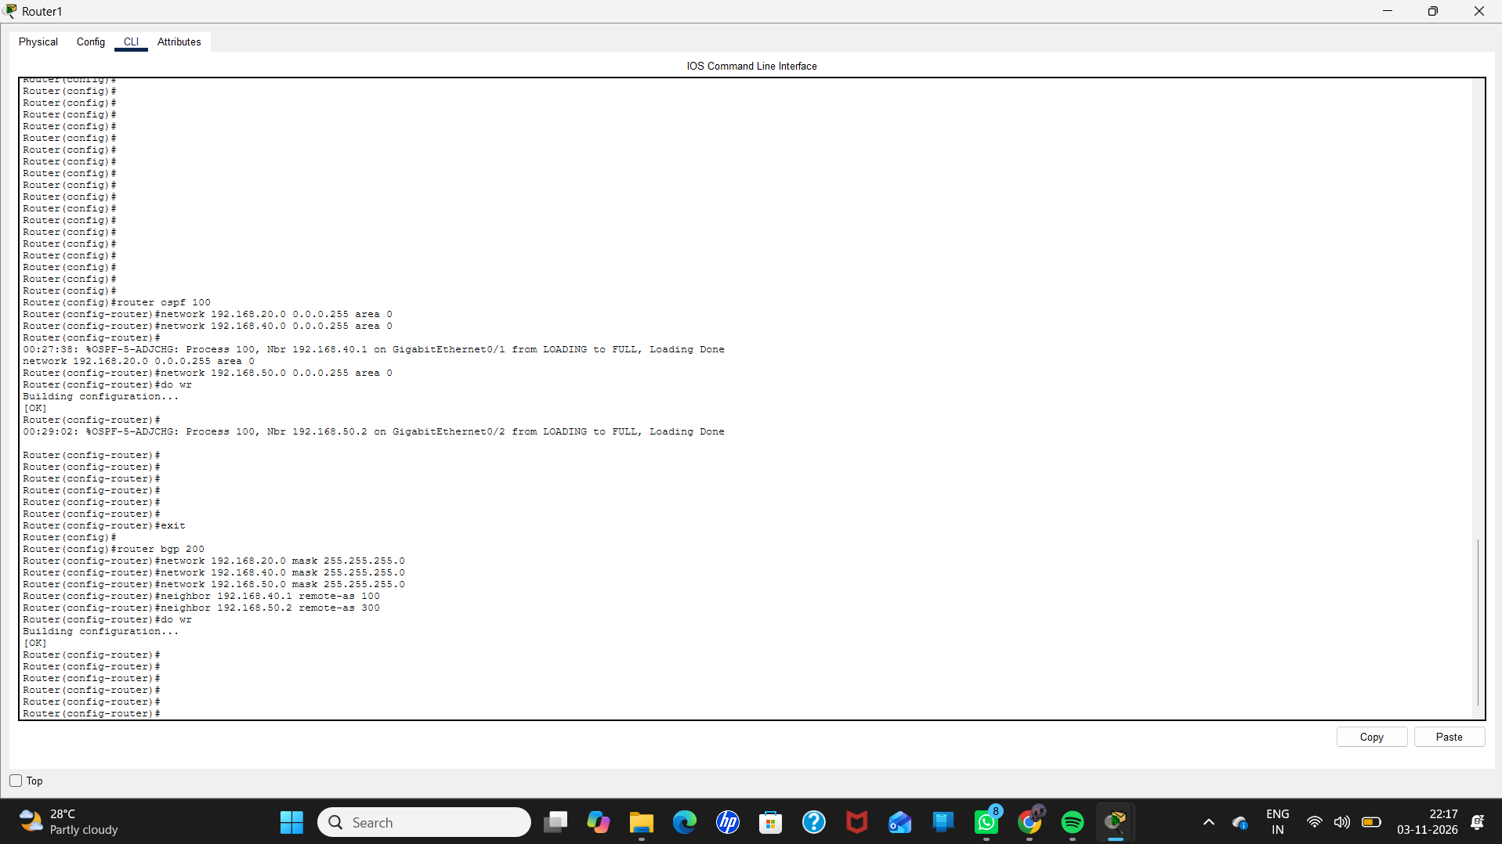

Slide 20


Slide 21


Slide 22
EIGRP – ENHANCED INTERIOR GATEWAY PROTOCOL

Slide 23


Slide 24
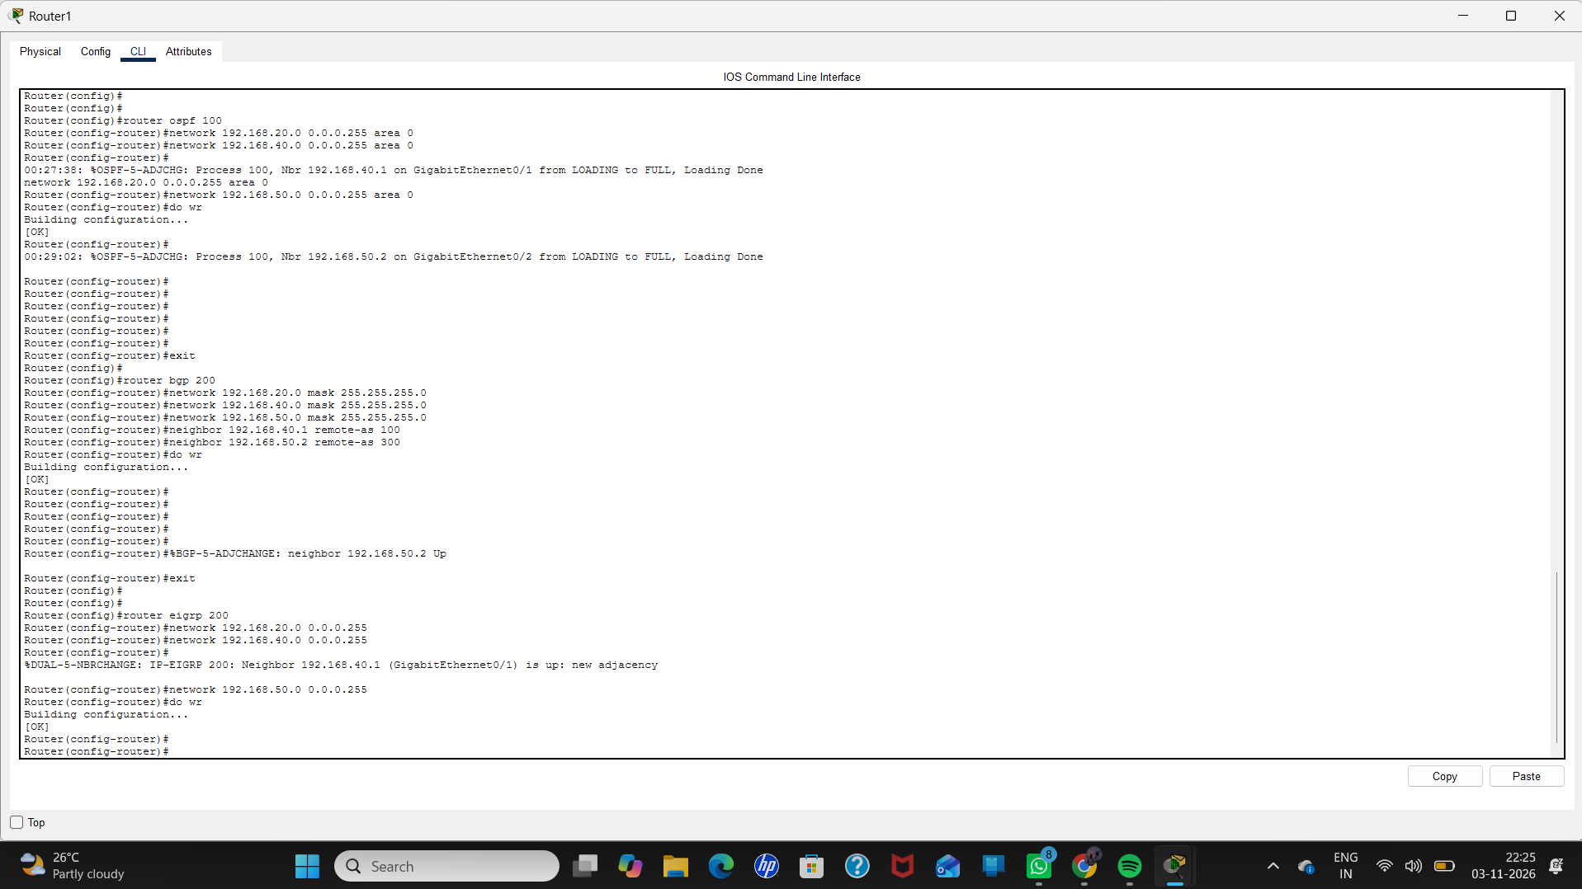

Slide 25
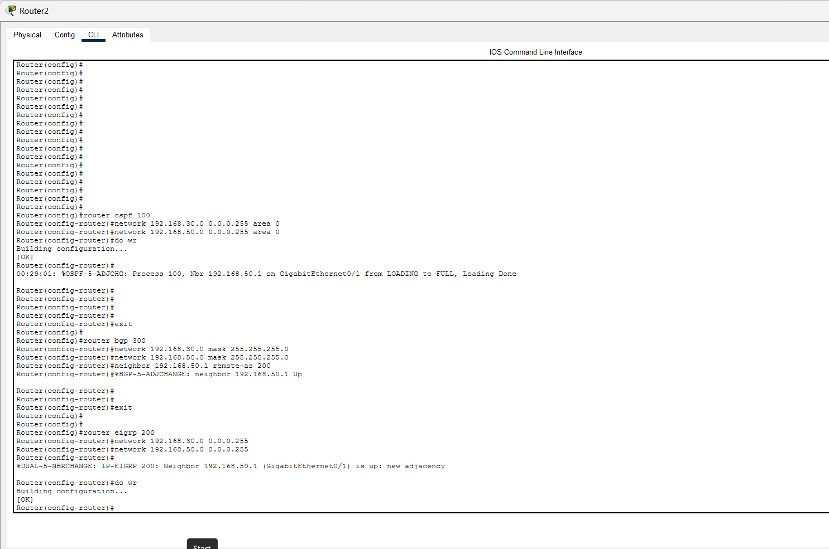

Slide 26


Slide 27


